Slide 1
SAAS Application of Zocdoc
North Carolina Department of Health and Human Services
Presented by:
Kerim Sever
Sefa Ozbek
Daniel
Leyki Reynoso

Slide 2
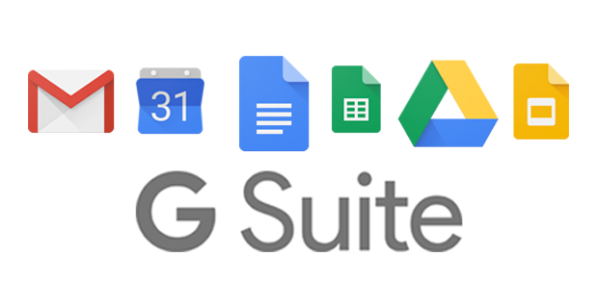




What is SAAS?
Software As A Service
Examples:
Salesforce
AWS
G Suite
Dropbox
Slack
https://sedcclint.com/index.php/2018/10/25/g-suite-for-beaver-pd-day/g-suite-logo/
https://en.wikipedia.org/wiki/File:Salesforce.com_logo.svg
https://mashable.com/article/slack-redesigned-new-logo
https://logos-world.net/amazon-web-services-logo/
https://commons.wikimedia.org/wiki/File:Dropbox_Logo_01.svg
Notes:
Sefa
SAAS is software as a service. It is a way of delivering software and application over the internet, meaning you don't need a copy of the application on your pc. More and more pieces of software and applications are moving towards SAAS to make it more convenient for the end user.
What is salesforce?
Provides a way for all of your departments and teams from all over the company to communicate using Customer 360, which is
a Customer Relationship Management tool. They offer this CRM tool as a service, because it is very expensive and
AWS
AWS provides many cloud computing services such as computing, databases, analytics, networking, front end web & mobile
development, development and management tools, IoT, security and enterprise applications. They provide all these
services at a fraction of the cost of what it would be to set them up yourself.
*DRAW ON EXPERIENCE FROM BOOTCAMP LAB ON AWS*
Talk about G Suite
Gmail, Google Cal, Drive
Talk about Slack
Talk about Dropbox

Slide 3
What Is ZocDoc?
Based in NYC, ZocDoc offers an online service that allows people find and book appointments for medical and dental care. It also allows people to rate doctors and dentists based on their experience.
By entering your personal information, you can sign up for ZocDoc services and find yourself a physician or dentist.
Even while a NYC-based company, they offer services that expand beyond the region.
Notes:
Sefa
Explain zocdoc to class:
What it is
What services it offers
How it does it
Explain why we chose zocdoc as well for a saas application

Slide 4
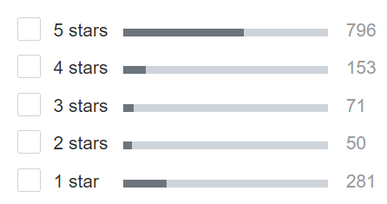
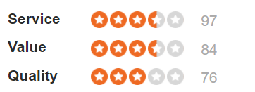
User Experience
Notes:
Leyki Reynoso jr

Slide 5
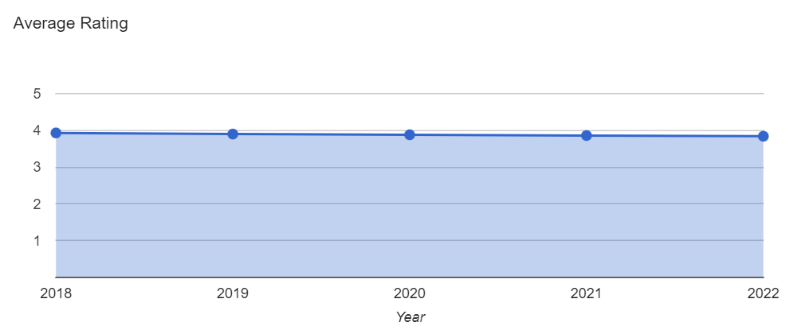
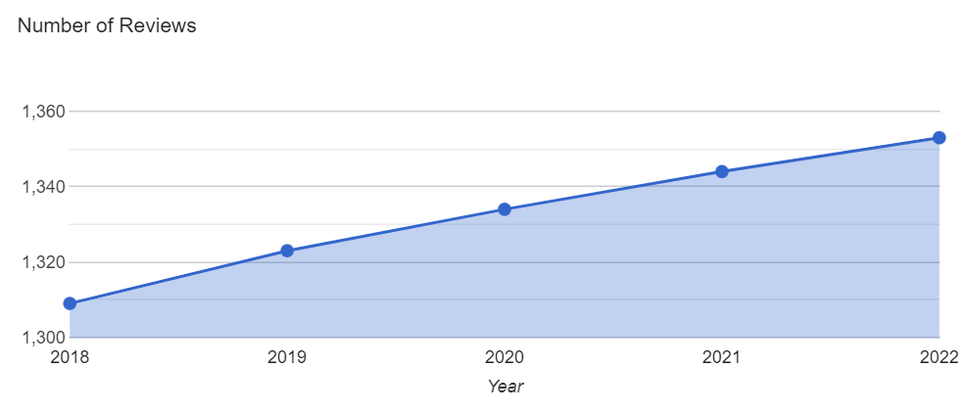

Slide 6
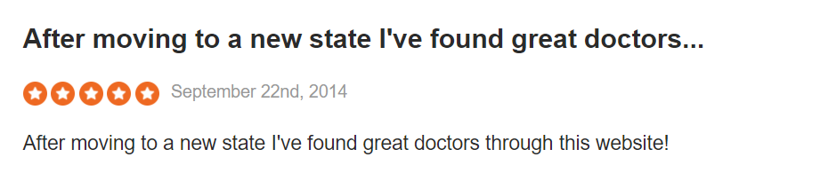
Most positives are about finding doctors

Slide 7
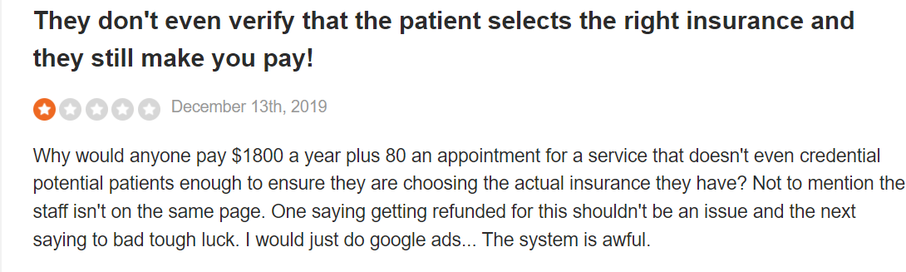
Problems selecting insurance

Slide 8
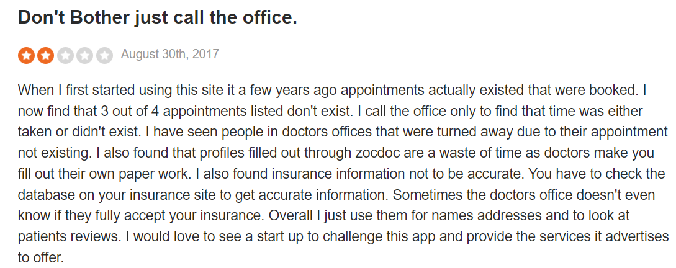
Setting appointments

Slide 9
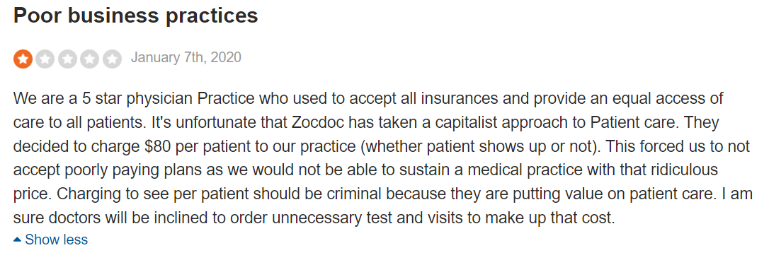
Providers hate it

Slide 10
User Interface
Simple and easy to understand landing page
Easy to create an account
Easy to search for doctors in local area
Displays reviews of doctors
Can book appointments through the website/app
Z-Layout format
Notes:
This and the pictures Kerim

Slide 11
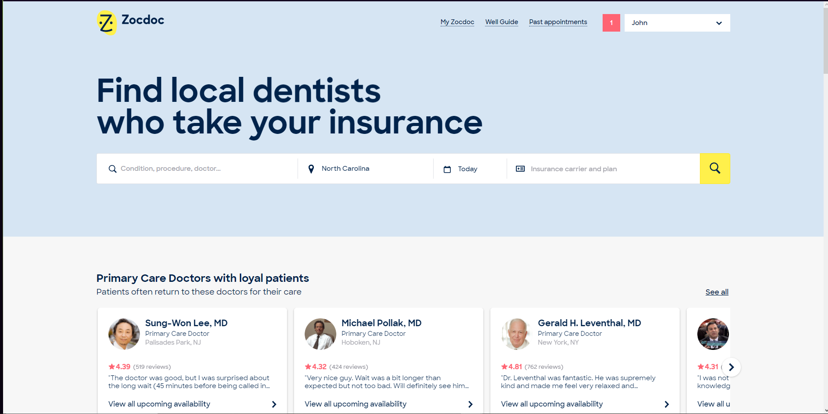
Landing Page

Slide 12
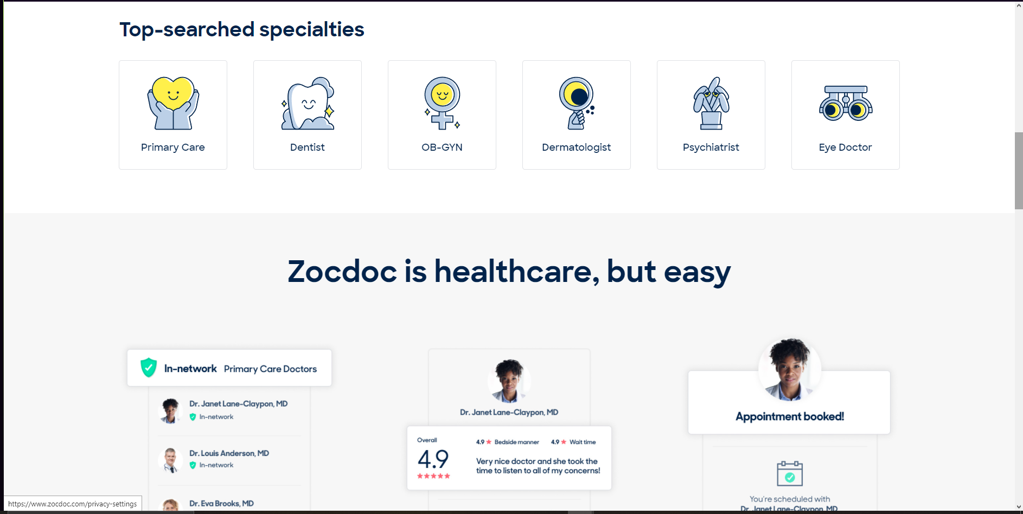

Slide 13
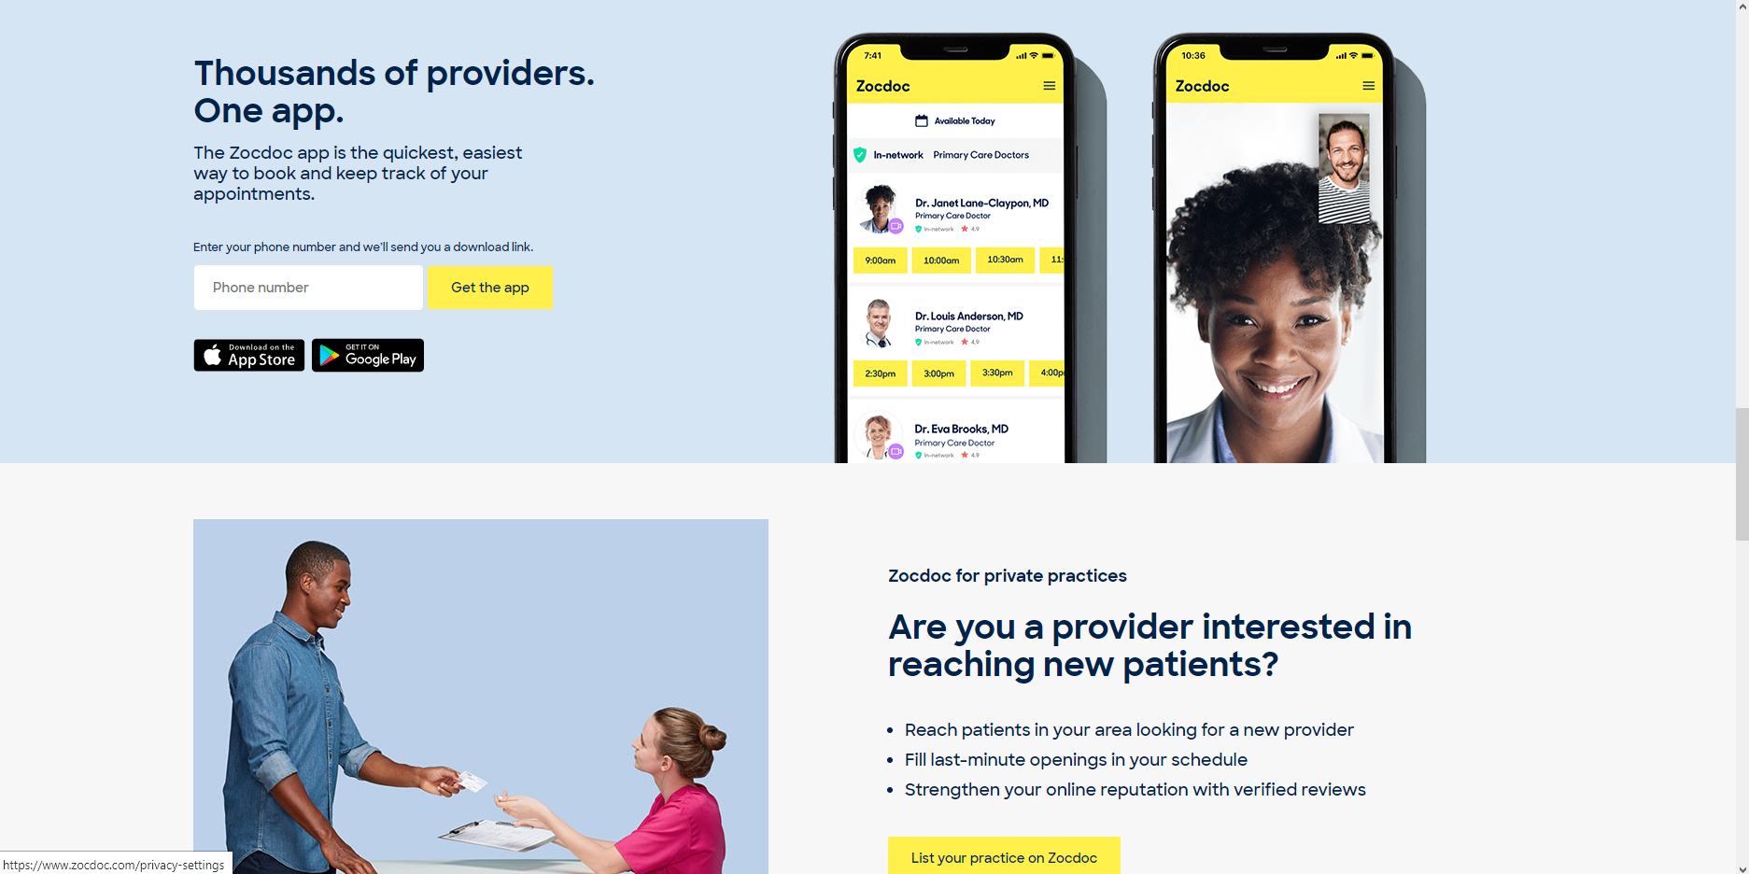

Slide 14
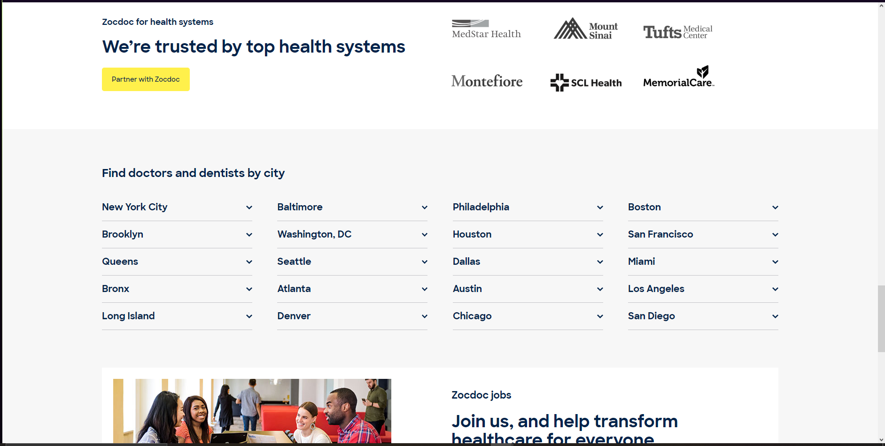

Slide 15
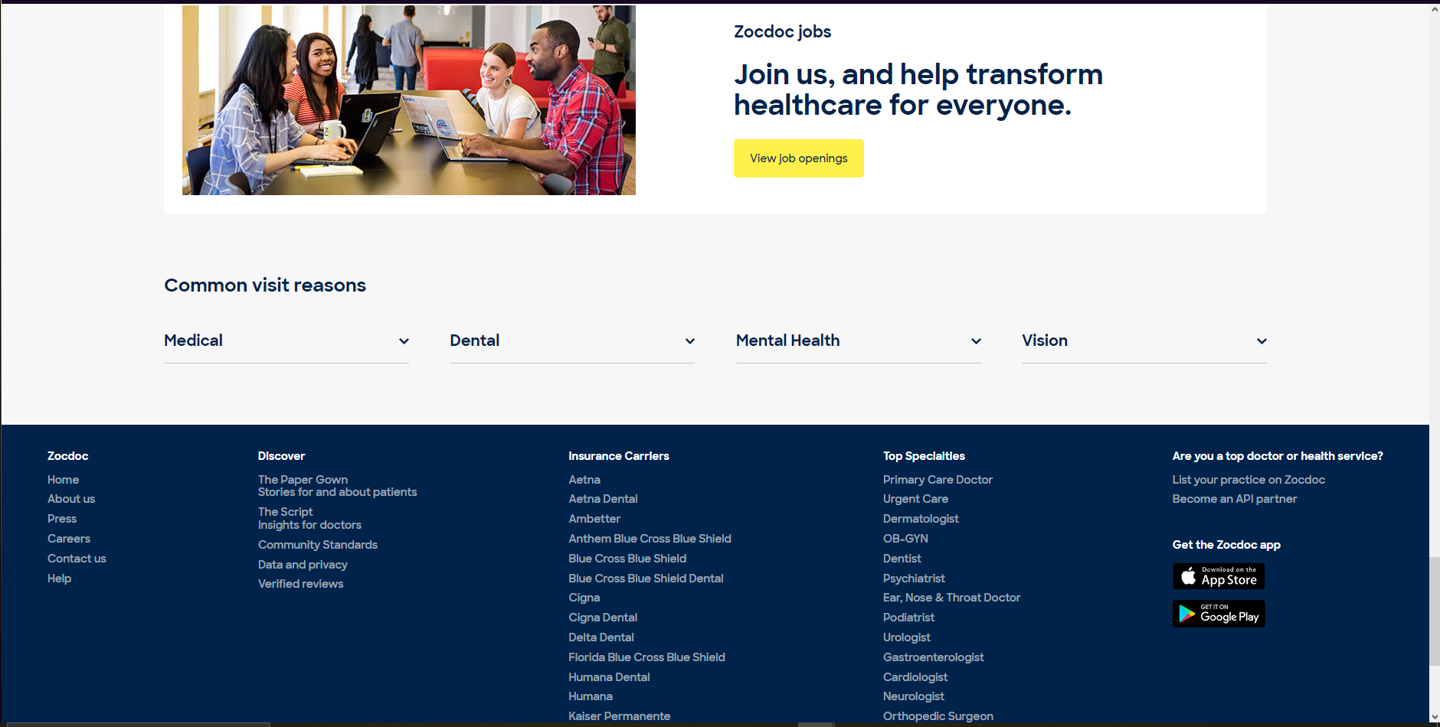

Slide 16
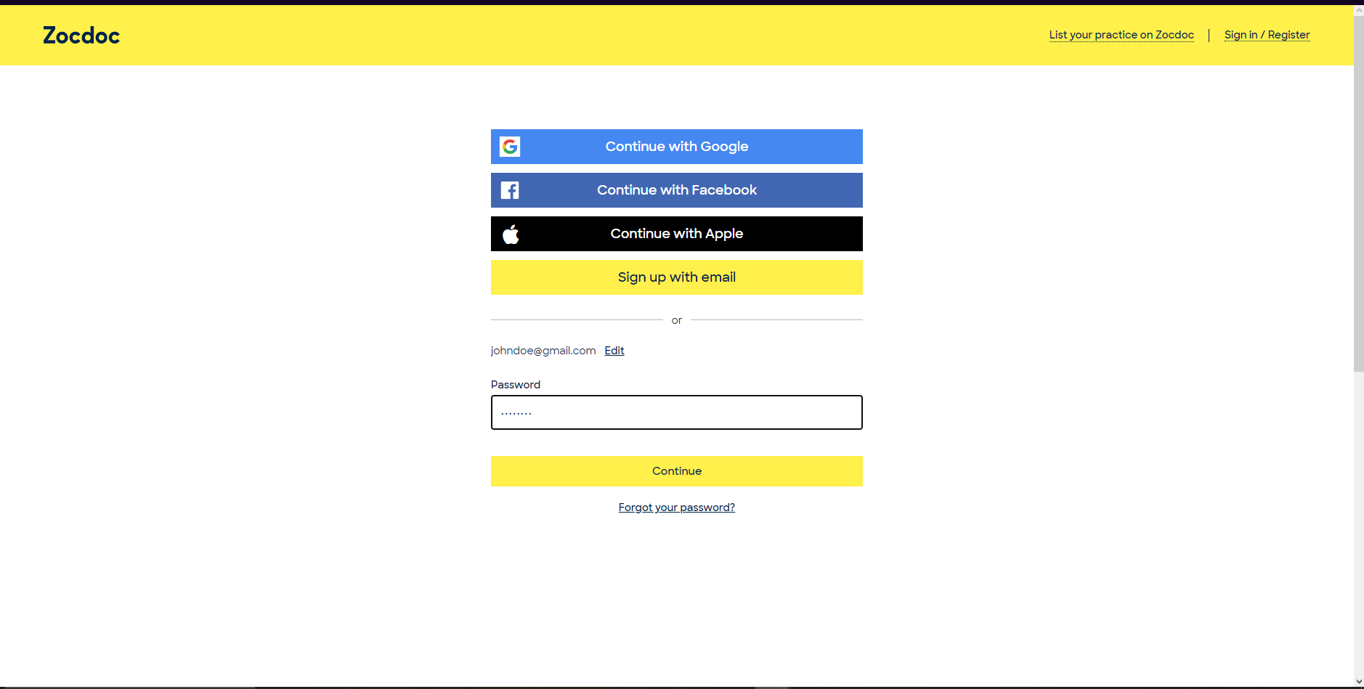

Slide 17
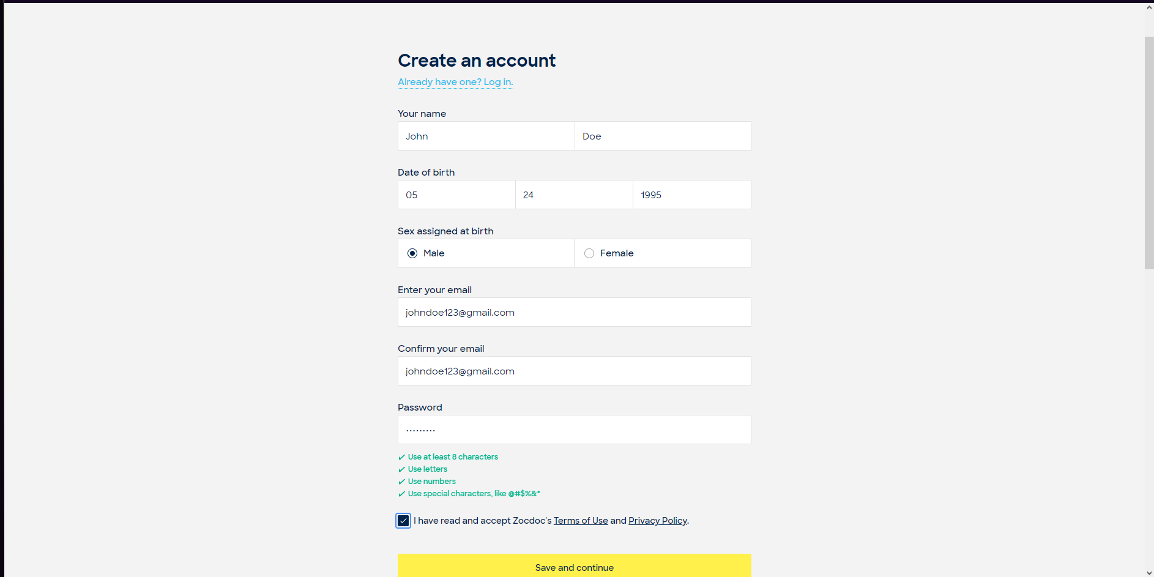

Slide 18
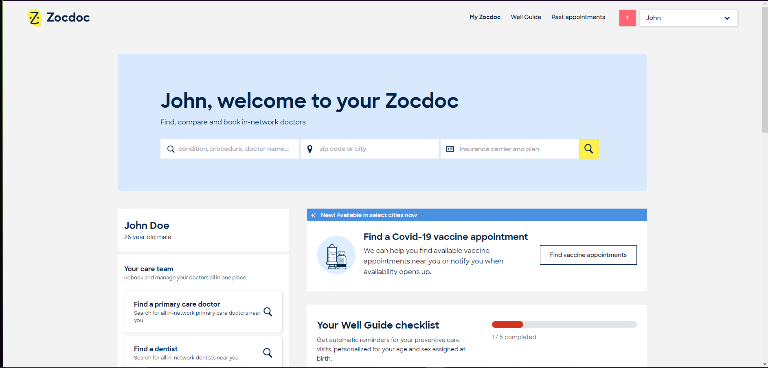

Slide 19
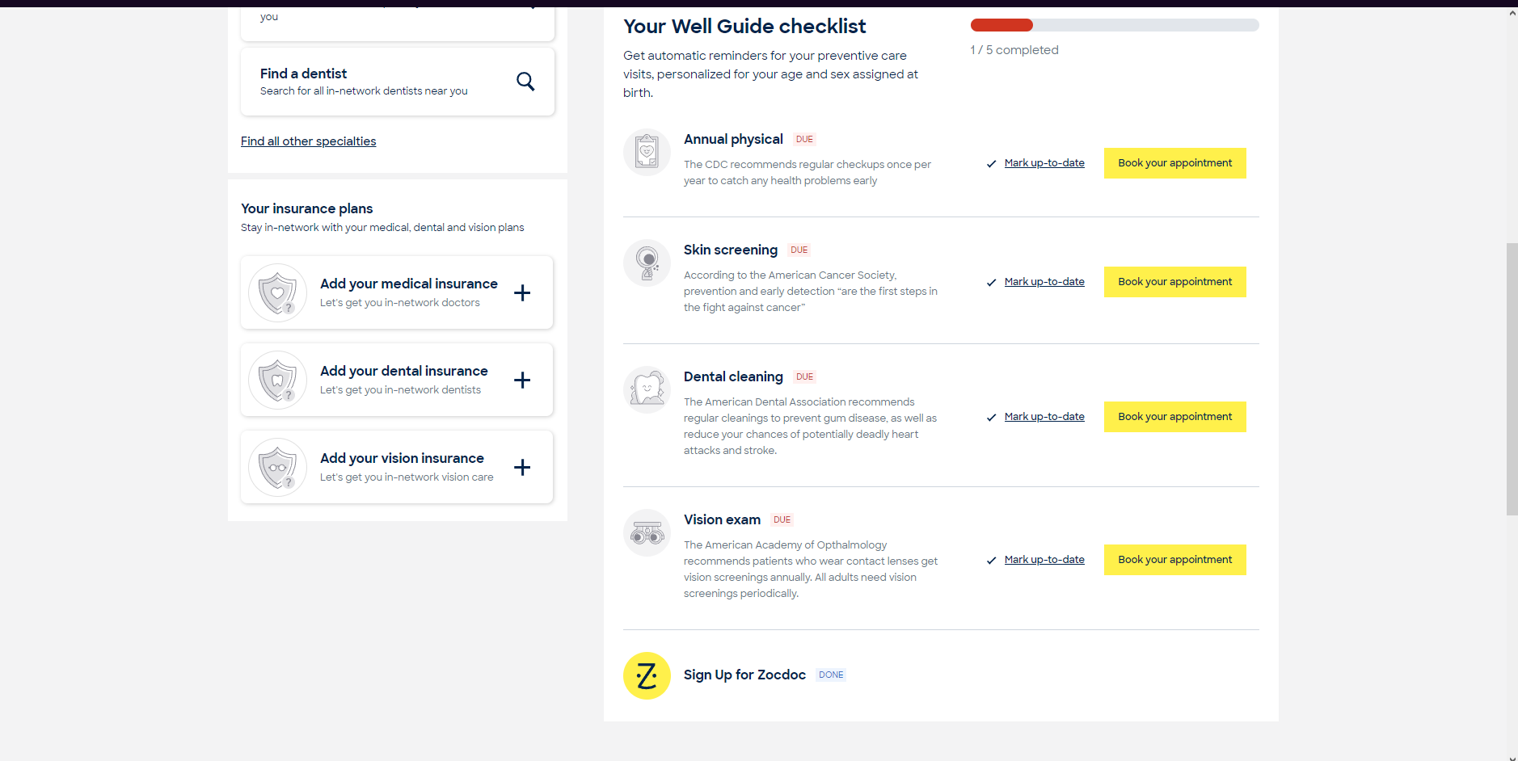

Slide 20
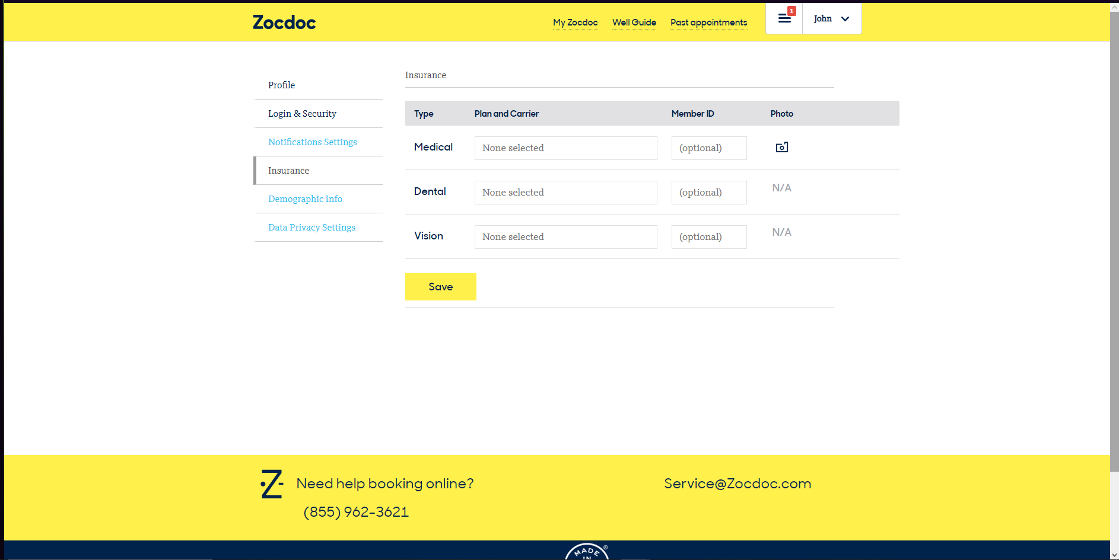

Slide 21
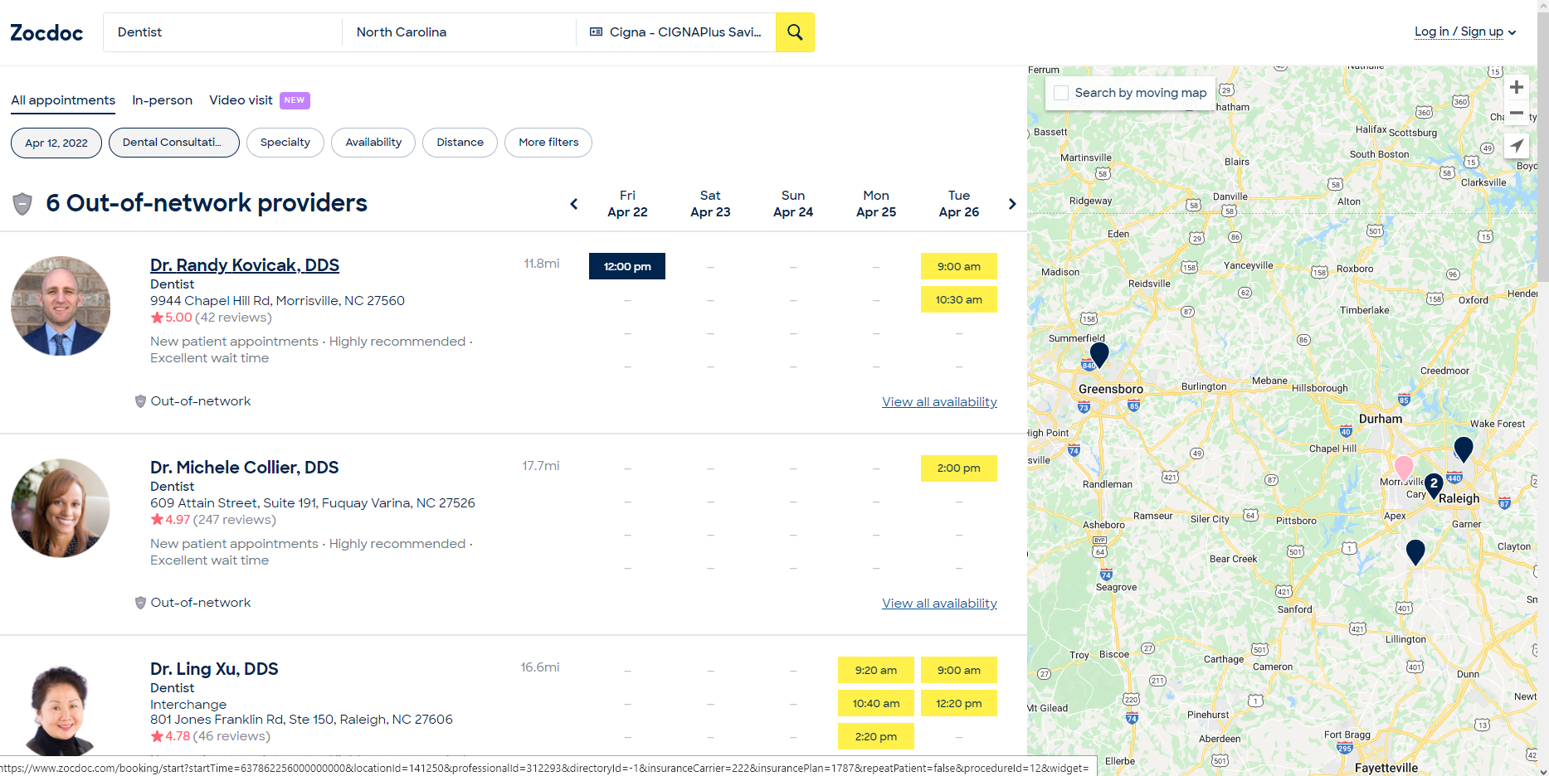

Slide 22
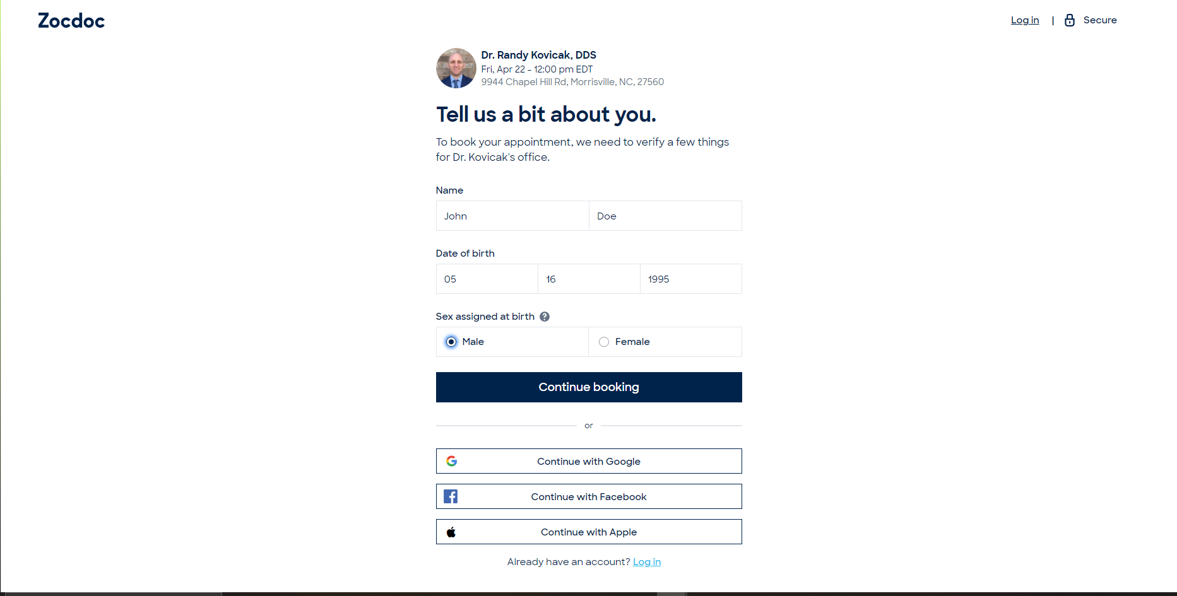

Slide 23
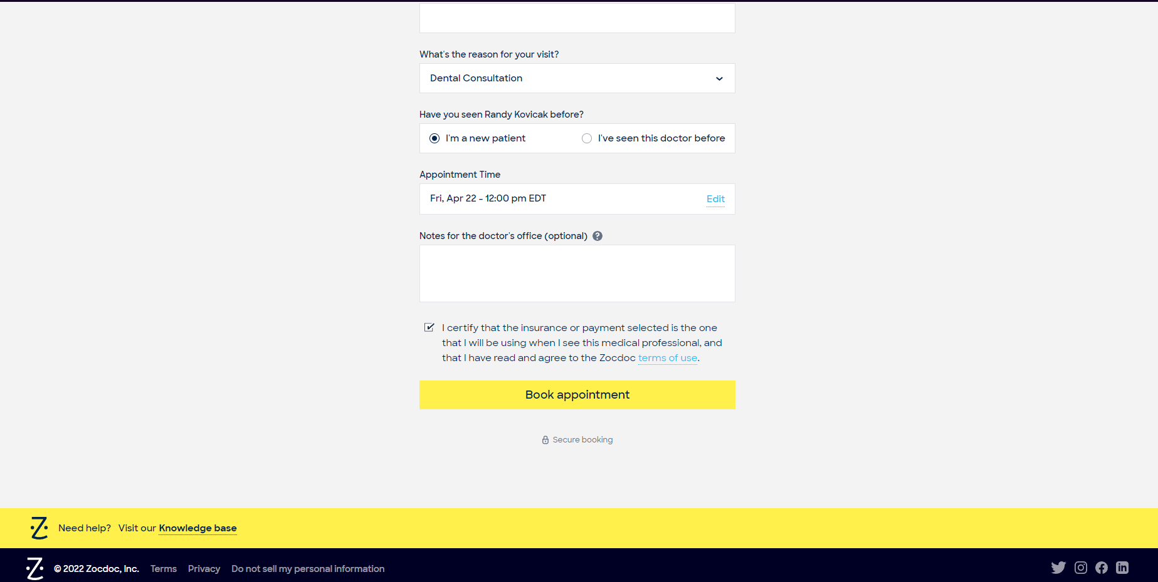

Slide 24
Things We Like About ZocDoc
Easy to use.
Clean interface.
Much more helpful than google maps.

Slide 25
Things We Would Change about ZocDoc
One thing we would like to add to ZocDoc is the ability to view the results of your medical appointment and past medical history.
Akin to the functionalities of AthenaHealth
For ZocDoc to work at its best it needs options. The best improvement we can do right now it's the addition of more doctors, so people have more options while using the application.
Notes:
Daniel

Slide 26

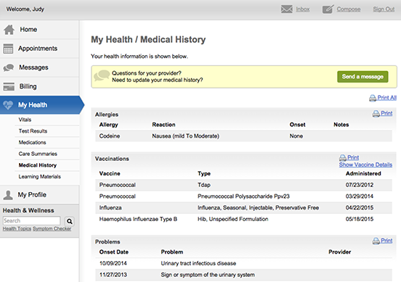
AthenaHealth Examples

Slide 27
Conclusion
The NCDHHS, and the population they serve, may benefit from integrating the services of ZocDoc into their healthcare systems.
In order to serve the well-being and health of the population, we should provide them with the adequate resources in order for them to find the right medical personnel.
Notes:
Daniel
Although it is not a perfect solution, ZocDoc will be a great starting point for the health department to fulfill the needs of the population, such as finding reliable medical personnel and creating appointments with ease.
Furthermore, the integrated ZocDoc will be expanded to provide more resources in viewing your appointments, and setting up health insurances, in order to provide a better user experience for the patients healthcare system.

Slide 28
Sources
https://joshfechter.com/software-service-examples/#13_Slack

